Slide 1


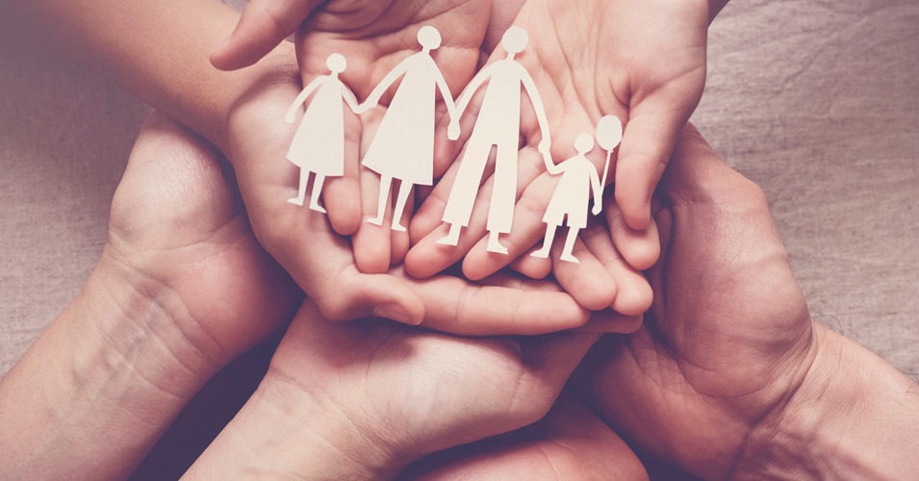
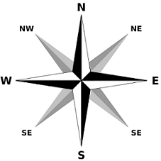
Blood Relations & Directions Sense

Slide 2
Blood Relation
A person who is related to another by birth or by marriage.
Maternal: related through the mother's side of the family.
Paternal: related through the father’s side of the family.
Siblings: Brothers or Sisters
Spouse: Husband or Wife
Note: Cousin is a Common Gender.

Slide 3

Type of Relationship | Terminology in Use
Mother’s or Father’s son | Myself/Brother
Mother’s or Father’s daughter | Myself/Sister
Mother’s or Father’s brother | Uncle
Mother’s or Father’s sister | Aunt
Mother’s or Father’s father | Grandfather
Mother’s or Father’s mother | Grandmother
Son’s wife | Daughter-in-law
Daughter’s husband | Son-in-law
Husband’s or wife’s sister | Sister-in-law
Husband’s or wife’s brother | Brother-in-law
Brother’s son | Nephew
Brother’s daughter | Niece
Uncle or aunt’s son or daughter | Cousin
Sister’s husband | Brother-in-law
Brother’s wife | Sister-in-law
Grandson’s or Granddaughter’s daughter | Great-granddaughter

Slide 4
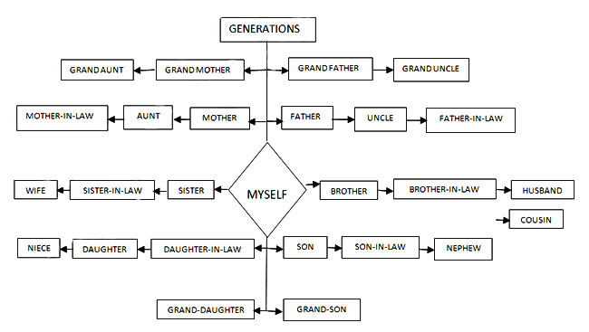

Slide 5

Problem Types
Conversation based
In such questions, one person describes his/her relationship with another person.
Puzzles based
A piece of brief information about multiple people being interrelated is given.
Symbols based
The relationship between two people may be denoted using symbols.

Slide 6

Representations
For more clarity, you may use these symbols while solving.
+ for male
– for female
to signify a couple
to signify same generation relationship (for e.g., brother-sister, brother-brother, sister-sister, etc.)
to signify different generation relationship (for e.g., father-son, mother-daughter, etc.)

Slide 7
Tips for solving
Apply the question to yourself.
Do not prejudge the gender.
Break the question into smaller parts, apply backtracking.
Attentive about Maternal, Paternal, Spouse, Cousin etc.
Draw clear diagrams as you solve.

Slide 8
Problem 1
Pointing to a man in the photograph a woman said,
“He is the brother of the daughter of the wife of my husband”
How is the man related to the woman?
Mother
Son
Cousin
Brother
Option b

Slide 9
Problem 2
Pointing to a man, Anu said,
“He is the only son of my grandmother’s only daughter.” How is the man related to Anu?
Cousin
Niece
Brother
Cannot be determined
Option d

Slide 10
Problem 3
Pointing to a girl in the photograph, Ajay said, "Her mother's brother is the only son of my mother's father." How is the girl's mother related to Ajay?
Mother
Sister
Aunt
a or c
Option d

Slide 11
Problem 4
Ravi is grandfather to Selvi. Balu is son of Ravi. Neetu is wife of Balu. Balu is brother of Kavi. Lakshmi is mother of Kavi. Selvi is daughter of Neetu. How is Lakshmi related to Neetu?
Sister
Mother
Mother-in-law
Aunt
Option c

Slide 12
Problem 5
Q is father of A and B. X is mother of K, N is son of A. N is the only brother of K. X is daughter-in-law of P. P has only one daughter and one son.
Which of the following needs to be true to establish that K is daughter of X?
No extra information is required
B is unmarried
X has only one son
N is grandson of Q
Option c

Slide 13
Problem 6
In Mr. Mehta’s family, there are one grandfather, one grandmother, two fathers, two mothers, one father-in-law, one mother in-law, four children, three grandchildren, one brother, two sisters, two sons, two daughters and one daughter-in-law. How many members (minimum) are there in Mr. Mehta’s family?
7 members
13 members
9 members
16 members
Option a

Slide 14
Problem 7
Prashant Arora has three children - Sangeeta, Vimal and Ashish. Ashish married Monika, the eldest daughter of Mr. and Mrs. Roy. The Roys married their youngest daughter to the eldest son of Mr. and Mrs. Sharma, and they had two children named Amit and Shashi. The Roys have two more children, Roshan and Vandana, both elder to Veena. Sameer and Ajay are sons of Ashish and Monika. Rashmi is the daughter of Amit. How is Mrs. Roy related to Ashish ?
A. Aunt B. Mother-in-law C. Mother D. Sister-in-law
Option B

Slide 15
Problem 8
Prashant Arora has three children - Sangeeta, Vimal and Ashish. Ashish married Monika, the eldest daughter of Mr. and Mrs. Roy. The Roys married their youngest daughter to the eldest son of Mr. and Mrs. Sharma, and they had two children named Amit and Shashi. The Roys have two more children, Roshan and Vandana, both elder to Veena. Sameer and Ajay are sons of Ashish and Monika. Rashmi is the daughter of Amit What is the surname of Sameer ?
Roy B. Sharma
C. Arora D. None of these
Option C

Slide 16
Soln: 7 & 8

Slide 17
Problem 9
If A + B means A is the mother of B; A x B means A is the father of B;
A $ B means A is the brother of B and A @ B means A is the sister of B, then which of the following means P is the son of Q?
A. Q + R @ P @ N B. Q + R * P @ N
C. Q x R $ P @ N D. Q x R $ P $ N
Option D

Slide 18
Problem 10
A # B means B is A’s wife;
A % B means B is A’s sister
A $ B means B is A’s mother;
A & B means B is A’s father
Which of the following means W is the aunt of X?
W $ X # Y % Z
X & Y # Z % W
Y & Z % X $ W
W # Z % Y & X
Option b

Slide 19

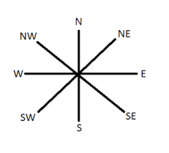
Direction Sense

Slide 20

Points to remember
At the time of sunrise, if a man stands facing the east, then his shadow will be towards the west.
At the time of sunset, the shadow of an object is always in the east.
If a man stands facing the North, at the time of sunrise his shadow will be towards his left and at the time of sunset, it will be towards his right.
Apply Pythagoras law to find the shortest distance.

Slide 21

Problem Types
Distance Related
Left Right Movement
Casting of Shadows
Symbol Based

Slide 22
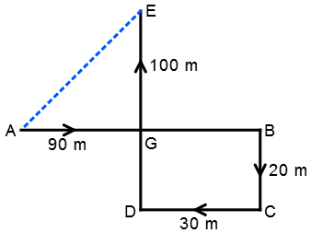
Problem 11
A child is looking for his father. He went 90 meters in the East before turning to his right. He went 20 meters before turning to his right again to look for his father at his uncle’s place 30 meters from this point. His father was not there. From here he went 100 meters to the North before meeting his father in a street. What is the smallest distance between the starting point and his father’s position?
80 meters
100 meters
140 meters
260 meters
Option B

Slide 23
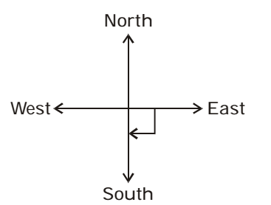
Problem 12
A direction pole was on the crossing. Due to an accident the pole turned in such a manner, that the pointer which was showing east started showing south. One traveler went to the wrong direction thinking it to be west. In what direction was he actually traveling?
South
East
West
North
Option D

Slide 24
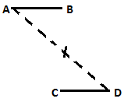
Problem 13
Five friends A, B, C, D and E are staying in the same locality. B’s house is to the east of A’s house and to the north of C’s house. C’s house is to the west of D’s house. D’s house is in which direction with respect to A’s house?
South-East
North-East
East
Data inadequate
Option A

Slide 25
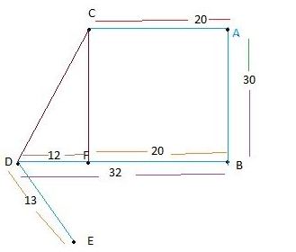
Problem 14
A is 20 m away from C in east direction. B is standing in south of A and is facing south direction and distance between A and B is 30 m. Now to the right of B, covering 32 m towards west, D is standing. D is eating ice-cream standing on its position and facing north. After eating ice cream D starts moving towards south-east direction covering 13 m and reaches to the position of E. What is the distance between D and C and C is in which direction with respect to D?
A. 32.3m, north-west
B. 31.7m, north-west
C. 32.3m, north-east
D. 31.7m, north-east
Option C

Slide 26
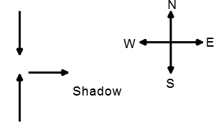
Problem 15
Two friends – Shyam and Ram were sitting in a park in the evening. Both were facing each other. Shyam noticed that Ram’s shadow was falling to his right. Which direction was Shyam facing?
A. West
B. East
C. North
D. South
Option D

Slide 27

Problem 16
If A x B means A is to the south of B;
A + B means A is to the north of B;
A % B means A is to the east of B;
A - B means A is to the west of B;
then in P % Q + R - S,
S is in which direction with respect to Q?
South-West
South-East
North-East
North-West
Option B

Slide 28

Thank You
Narayan
CIR

